Slide 1
Driving in Maryland: Everything you need to know to get licensed
UMBC IES Office
Administration Building, Room 224
ies@umbc.edu; 410-455-2624

Slide 2
Getting Started: Which Category do YOU fit in?
I’ve never had a license to drive
2. I have/had a license in another country
3. I have/had a license from Canada, France, Germany or South Korea

Slide 3
Never had a license to drive? Let’s get started…
A lot to learn!
Steps:
Learner’s Permit
Provisional License
Driver’s License
Note – MUST have Active SEVIS record for at least 2 days to take any action at MVA

Slide 4
Learner’s Permit
Allows you to drive with supervision of experienced driver
Other person must be 21; had license for 3 years; sit next to you at all times
Must have learner’s
permit 9 months before
testing for Provisional
License

Slide 5
Applying for your Learner’s Permit (overview)
Go to an MVA office to…
Pass a Knowledge test
Pass a Vision Test
Provide documentation of your legal status in the US (I-20, passport, visa, I-94 card/printed record)
Provide SSN (Social Security number) OR letter from SSA (Social Security Administration) that you are ineligible
Provide documentation of Maryland residency
Under 18 years old? Need a signature from a parent or guardian

Slide 6
Learner’s Permit -- Knowledge Test
Computerized test of 20 questions
Study ahead of time using the MVA Maryland Driver’s Handbook (IES office has copies of this, or go online)
Practice test questions here: http://www.mva.maryland.gov/Driver-Services/RookieDriver/tutorial/Tutorial_intro.html
(includes links to online Handbook to study)

Slide 7
Vision Test
Used to make sure your eye sight is sufficient for driving
Small machine you look into, respond to prompts
Use contact lenses or glasses? You can wear them during the test; noted on your license
More information:
http://www.mva.maryland.gov/Driver-Services/VisionScreen/default.htm

Slide 8
Proof of Legal Immigration Status
I-20 must be signed by you and IES adviser
Visa can be expired
Passport must be valid
I-94 must be valid
All documents have to be verified through the SAVE (Systematic Alien Verification for Entitlements) program – may or may not be done the same day. Can take up to 3 weeks.

Slide 9
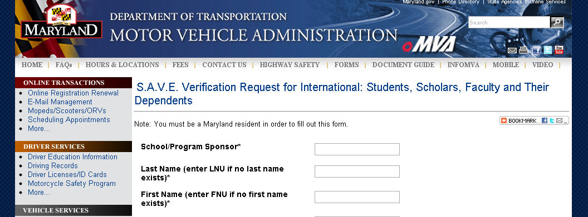
SAVE Verification
You can start the SAVE process in advance, online! http://www.mva.maryland.gov/save.htm

Slide 10
SSN or Proof of Ineligibility
If you have an SSN, take card with you to MVA
If you do NOT have an SSN:
Request letter of F-1 status from IES office
Go to SSA Office with all immigration documents and IES letter
Request “Letter of Ineligibility” at SSA office -- states that you are not eligible for an SSN (because you don’t work in the US)

Slide 11
Proof of Maryland Residency
To prove that you are living in Maryland, please take at least TWO of the following:
Phone/Utility/Cable bill mailed to you at your Maryland address
Rental/Lease agreement for where you are living
Bank Account statement from Maryland bank
Credit Card bill mailed to your Maryland address
For other options, use this link: http://www.mva.maryland.gov/Driver-Services/Apply/proof.htm#MD_residency

Slide 12
I have my Learner’s Permit, Now What?
Valid for 2 years
Must have for at least 9 months before you can test for Provisional License
You will receive a Practice Log Book – must complete 60 hours of practice with a supervising driver – over 21 years old, licensed at least 3 years
Required to take a Driver Education class, usually about 8 weeks long; requires cost. Find one here: http://www.mva.maryland.gov/drivers/rookie-driver/

Slide 13
Provisional License
Next step for Learner’s Permit holder
FIRST step for individuals holding a license from another country
For students with licenses from another country – the rules are not clear how long you can use your international license in Maryland, but to be safe we recommend that you get your Maryland license within the first 3 months you are here.

Slide 14
Provisional License – What is it?
Probationary (“trial”) License
Need to maintain a “clean driving record” before you can get a full license
Can drive alone 5:00am – 12:00am midnight; need a supervising driver 12:00am – 5:00am
Under 18 years old? Cannot have passengers under 18 in the car without supervisor

Slide 15
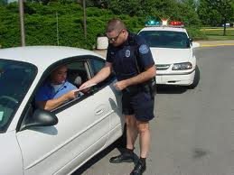
“A Clean Record”– What is that?
You have not received any traffic tickets/ “moving violations”
You can get a ticket if a policeman stops you because you are breaking a traffic law
Common offenses – speeding, reckless driving, illegal passing of other cars, running a STOP sign or red light, etc.

Slide 16
Applying for your Provisional License (overview)
You must have passed a Vision test and Knowledge Test (if you didn’t need to get a Learner’s Permit, you take these at the MVA when you are ready)
Must take all immigration documents and SSN card or SSN letter of ineligibility
Must provide proof of Maryland residency (see previous slide on providing this information)
Attend and pass 3-hour “Drug and Alcohol Education” class
Schedule a time with the MVA to take the Skills Test
If you have a license from another country, it must be in English, or translated to English through an MVA-certified translation company

Slide 17
Provisional License – 3 hour Drug and Alcohol Class
Required if you have an international driver’s license
Cost involved; varies by program
Some online options exist
Find a class here: http://www.mva.maryland.gov/About-MVA/INFO/26200-678/26200-09T.htm

Slide 18
Provisional License – Skills Test
Driving Test taken with an MVA staff member
Taken on site at the MVA
Drive through a course demonstrating skills like 3-point turning and parallel parking
Drive on the road, follow directions of MVA staff
Common not to pass the first time – can reschedule soon after to try again
Must have a car to use for the test that is in good condition

Slide 19
Provisional License – Time line
How long do you need your provisional license before it becomes a full license?
Previously licensed 0-6 months: 18 months
Previously licensed 6-12 months: 12 months
Previously licensed 12-18 months: 6 months
If you have a clean driving record, you can then go to the MVA and “renew” your license to get a regular driver’s license

Slide 20
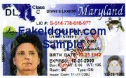
Driver’s License
Congratulations on your license!
Don’t forget to keep it current--don’t let it expire. Renew your license through the MVA. (You often receive reminders of expiration from the MVA by mail)
You can use your license as a form of personal ID.
Drive safe!

Slide 21
Citizens of Canada, France, Germany or South Korea
Special driving agreements exist between these countries and the US
Typically, you must have a current or recently-expired license from your country of citizenship
Waives some requirements
Look for specific details here: http://www.mva.maryland.gov/Driver-Services/Apply/international.htm#Foreign_Reciprocity

Slide 22
Car Registration and Car Insurance
Once you want to buy a car, you must first purchase car insurance.
Many different insurance companies are available. Research the best deals.
Once you buy a car, you must register it with the state of Maryland.
For guidance on buying, selling, and registering your car, use this link: http://www.mva.maryland.gov/Vehicle-Services/REG/default.htm

Slide 23
Links to MVA information
Online Maryland Driver’s Handbook: http://www.mva.maryland.gov/Resources/DL-002A.pdf
Learner’s Permit: http://www.mva.maryland.gov/Driver-Services/RookieDriver/bgenerallearners.htm
Provisional License: http://www.mva.maryland.gov/Driver-Services/RookieDriver/bgeneralprovisional.htm
Information specific to international drivers: http://www.mva.maryland.gov/Driver-Services/Apply/international.htm

